Slide 1

Cost-Volume-Profit Relationships
CHAPTER 5
As edited by PROF DUQUETTE
3-2-23
Managerial Accounting
Seventeenth edition

Slide 2
Learning Objective 1
Explain how changes in activity affect contribution margin and net operating income.

Slide 3
Cost-Volume-Profit Analysis: Key Assumptions
To simplify CVP calculations, managers typically adopt the following assumptions with respect to these factors:
Selling price is constant. The price of a product or service will not change as volume changes.
Costs are linear and can be accurately divided into variable and fixed components. The variable costs are constant per unit and the fixed costs are constant in total over the entire relevant range.
In multiproduct companies, the mix of products sold remains constant.

Slide 4
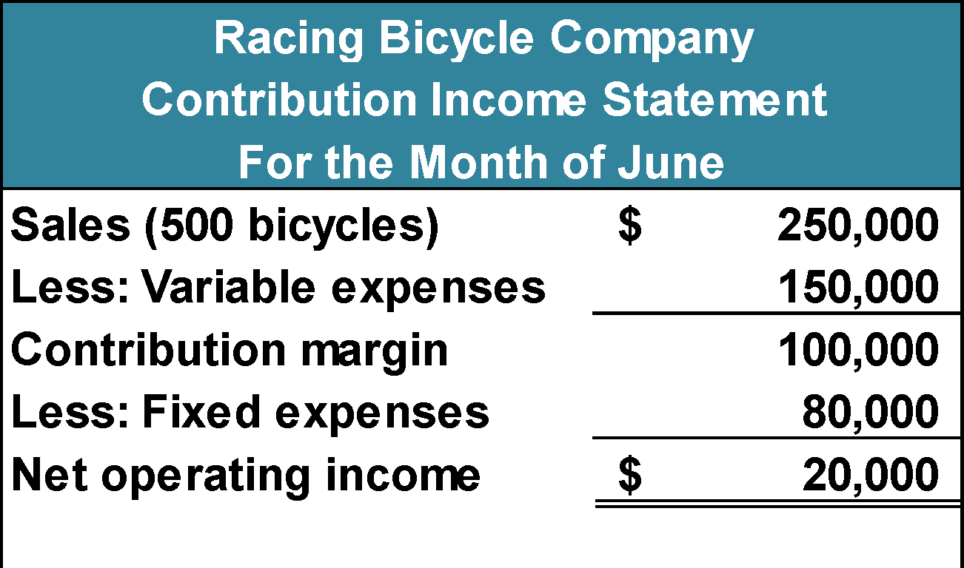
Basics of Cost-Volume-Profit Analysis –Part 1
The contribution income statement is helpful to managers in judging the impact on profits of changes in selling price, cost, or volume. The emphasis is on cost behavior.
Contribution Margin (CM) is the amount remaining from sales revenue after variable expenses have been deducted.

Slide 5
Basics of Cost-Volume-Profit Analysis – Part 2
CM is used first to cover fixed expenses.
Any remaining CM contributes to net operating income.

Slide 6
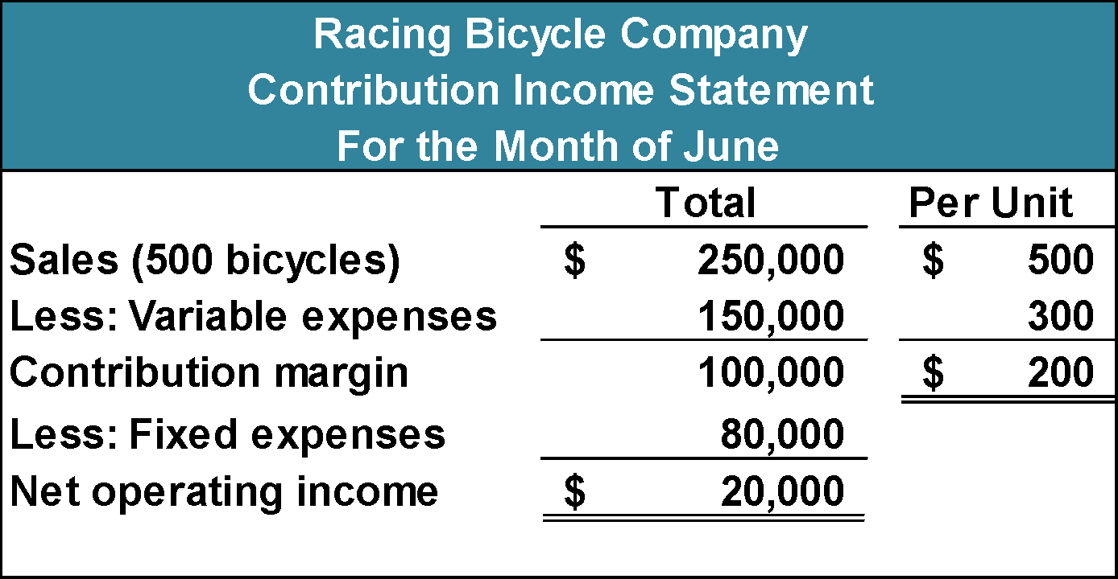
The Contribution Approach – Part 1
Sales, variable expenses, and contribution margin can also be expressed on a per unit basis. If Racing sells an additional bicycle, $200 additional CM will be generated to cover fixed expenses and profit.

Slide 7
The Contribution Approach – Part 2
Each month, RBC must generate at least $80,000 in total contribution margin to break-even (which is the level of sales at which profit is zero).

Slide 8
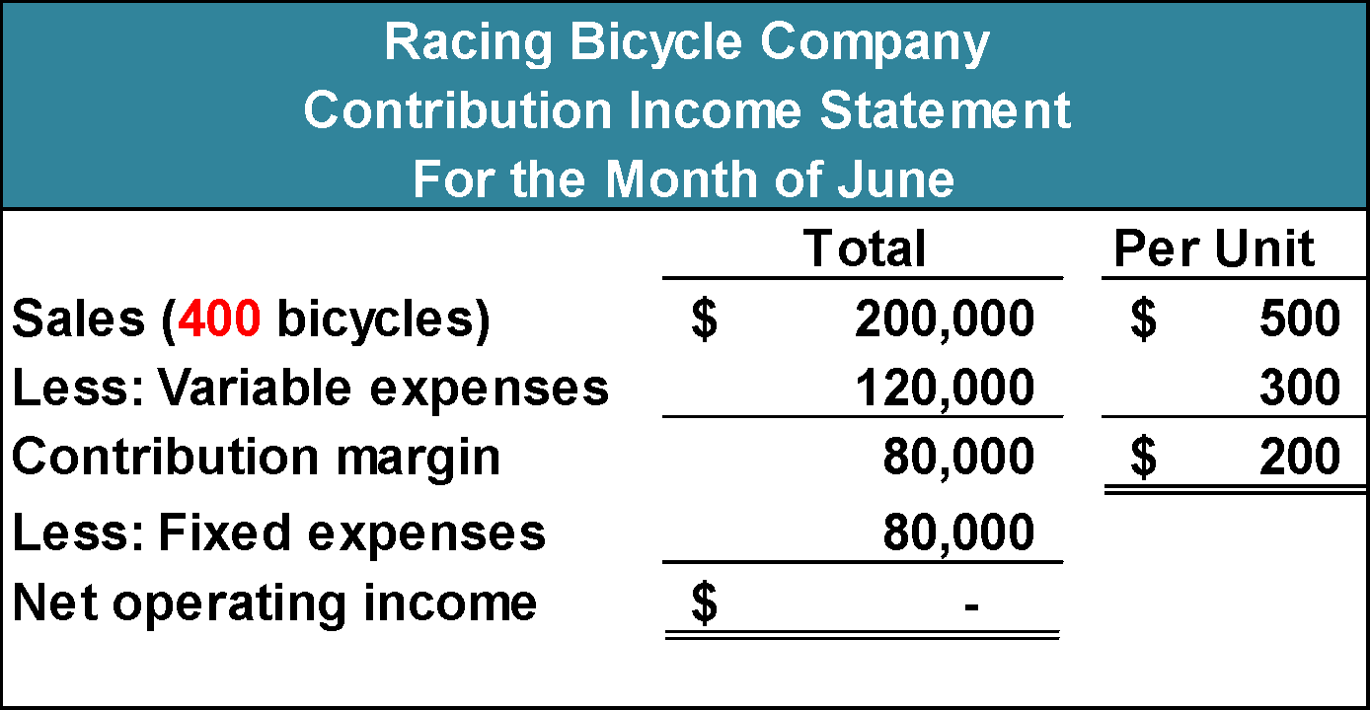
The Contribution Approach – Part 3
If RBC instead sells only 400 units in a month, it will be operating at the break-even point.

Slide 9
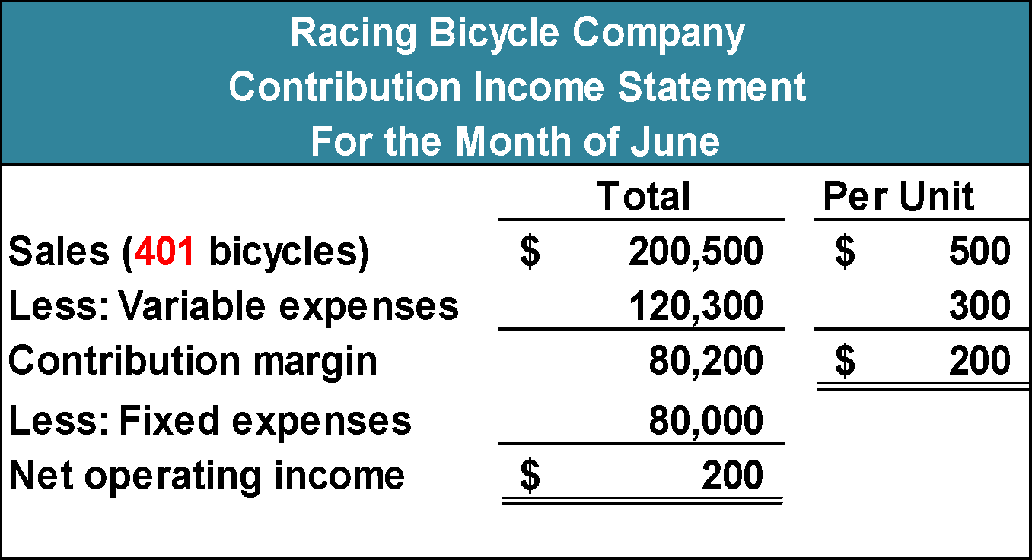
The Contribution Approach – Part 4
If RBC sells one more bike (401 bikes), net
operating income will increase by $200.

Slide 10
The Contribution Approach – Part 5
We do not need to prepare an income statement to estimate total profits at a particular sales volume. Simply multiply the number of units sold above break-even by the contribution margin per unit.
If RBC sells 430 bikes, ie 30 bikes above BE, its net operating income will be $6,000
(30 units × $200 per unit).

Slide 11
CVP Relationships in Equation Form
The contribution format income statement can be expressed in the following equation:
Profit = (Sales – Variable expenses) – Fixed expenses

Slide 12
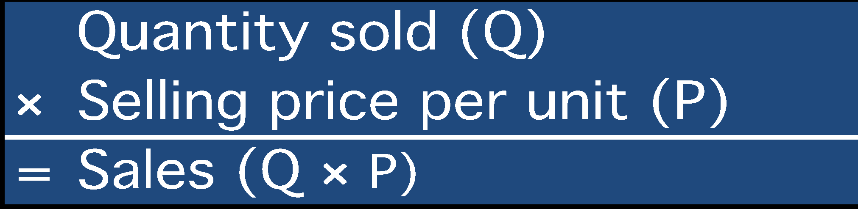

CVP Relationships in Equation Form – Detail Breakdown
When a company has only one product we can further refine this equation as shown on this slide.
Profit = (Sales – Variable expenses) – Fixed expenses
Profit = (P × Q – V × Q) – Fixed expenses

Slide 13
CVP Relationships in Equation Form – RBC Example
This equation can be used to show the profit RBC earns if it sells 401. Notice, the answer of $200 mirrors our earlier solution.
Profit = (Sales – Variable expenses) – Fixed expenses
401 units × $500
$80,000
401 units × $300
Profit = ($200,500 – $120,300) – $80,000
$200 = ($200,500 – $120,300) – $80,000

Slide 14
CVP Relationships in Equation Form – RBC Example Showing Detail
Profit = (Sales – Variable expenses) – Fixed expenses
Profit = (P × Q – VC per unit × Q) – FC
$200 = ($500 × 401 – $300 × 401) – $80,000
Profit = ($500 × 401 – $300 × 401) – $80,000

Slide 15
CVP Relationships in Equation Form – The Unit Contribution Margin as a shortcut
It is often useful to express the simple profit equation in terms of the unit contribution margin (Unit CM) first:
Unit CM = Selling price per unit – Variable expenses per unit
Unit CM = P – V
and then subtract out the Fixed costs, as follows:
Profit = (P × Q – VC per unit × Q) – FC
Profit = (P – VC per unit ) × Q – FC
Profit = Unit CM × Q – FC

Slide 16
CVP Relationships in Equation Form – RBC Example Using Unit CM shortcut to determine profit at 401 bikes
Profit = (P × Q – V × Q) – Fixed expenses
Profit = (P – V) × Q – Fixed expenses
Profit = Unit CM × Q – Fixed expenses
Profit = ($500 – $300) × 401 – $80,000
Profit = $200 × 401 – $80,000
Profit = $80,200 – $80,000
Profit = $200

Slide 17
Poll 1
If the contribution margin is not sufficient to cover fixed expenses:
a. total profit must be equal to total expenses
b. contribution margin must have been negative
c. a loss occurs
d. variable expenses must be exceeding total revenue

Slide 18
Poll 2
Total Profit can be expressed as: (P per unit –V per unit) x Q units – (Fixed Expenses).
True
False

Slide 19
Learning Objective 2
Prepare and interpret a cost-volume-profit (CVP) graph and a profit graph.

Slide 20
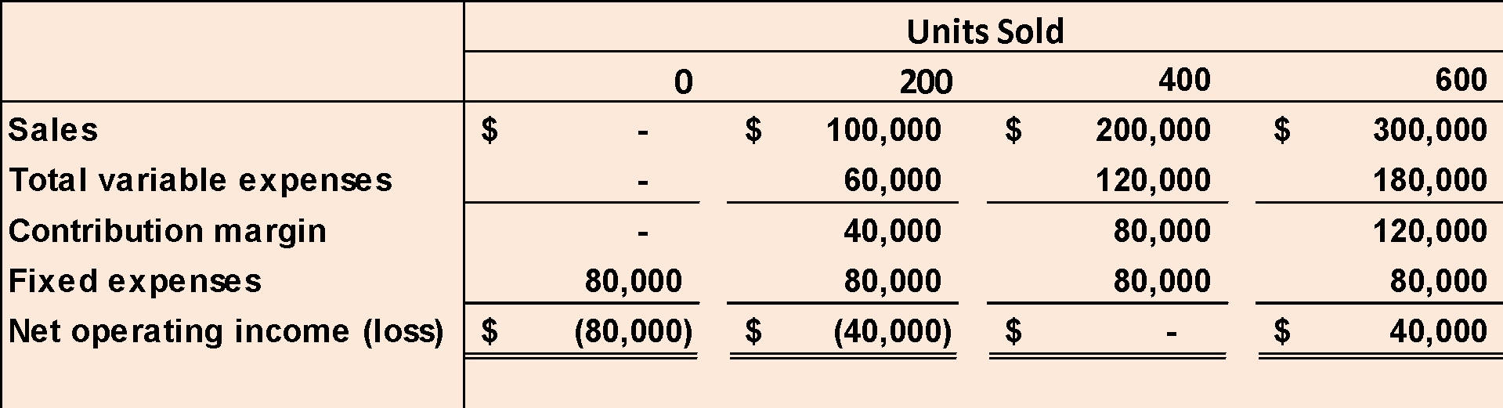
CVP Relationships in Graphic Form
The relationships among revenue, cost, profit, and volume can be expressed graphically by preparing a CVP graph. Racing Bicycle developed contribution margin income statements at 0, 200, 400, and 600 units sold. We will use this information to prepare the CVP graph.

Slide 21
Preparing the CVP Graph – Step 1
Dollars
In a CVP graph, unit volume is usually represented on the horizontal (X) axis and dollars on the vertical (Y) axis.
Units

Slide 22
Preparing the CVP Graph – Step 2
Draw a line parallel to the volume axis to represent total fixed expenses.
Dollars
Units

Slide 23
Preparing the CVP Graph – Step 3
Choose some sales volume, say 400 units, and plot the point representing total expenses (fixed and variable). Draw a line through the data point back to where the fixed expenses line intersects the dollar axis.
Dollars
Units

Slide 24
Preparing the CVP Graph – Step 4
Choose some sales volume, say 400 units, and plot the point representing total sales. Draw a line through the data point back to the point of origin.
Dollars
Units

Slide 25
Preparing the CVP Graph – Break-Even Point
Break-even point (400 units or $200,000 in sales)
Profit Area
Dollars
Loss Area
Units

Slide 26
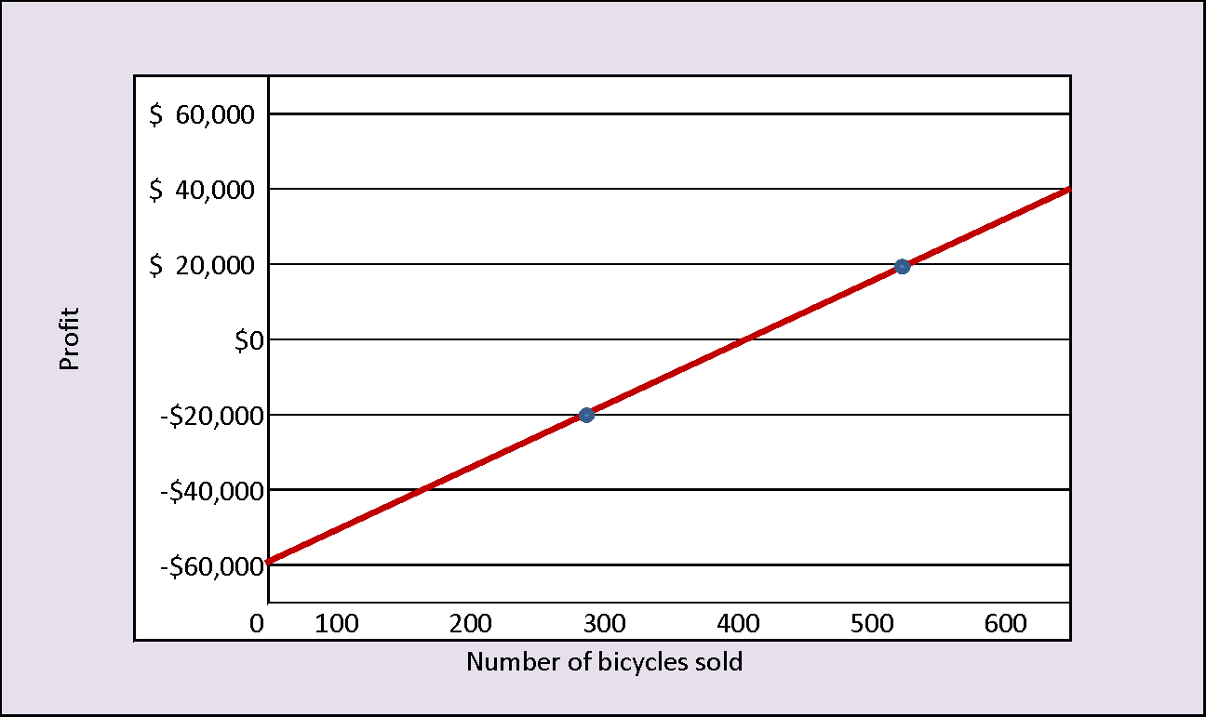
Preparing the Profit Graph – Simple Form
Profit = Unit CM × Q – Fixed Costs
An even simpler form of the CVP graph is called the profit graph.

Slide 27
Preparing the Profit Graph – Showing Break-Even Point
Break-even point, where profit is zero, is 400 units sold.

Slide 28
Poll 3
Which of the following statements is correct with regard to a CVP graph?
a. A CVP graph shows the maximum possible profit
b. A CVP graph shows the break-even point as the intersection of the total sales revenue line and the total expense line
c. A CVP graph assumes that total expense varies in direct proportion to unit sales
d. A CVP graph shows the that total expense varies at a same rate upward as sales volume increases starting at zero sales

Slide 29
Poll 4
In a CVP graph, Variable Cost per unit remains constant, resulting in the upward sloping portion of the cost line.
True
False

Slide 30
Learning Objective 3
Use the contribution margin ratio (CM ratio) or variable expense ratio to compute changes in contribution margin and net operating income resulting from changes in sales volume.

Slide 31

Step 1A: Contribution Margin Ratio (CM Ratio)
The contribution margin as a percentage of sales is referred to as the contribution margin ratio (CM ratio). This ratio is computed as follows:
For RBC, the contribution margin ratio is calculated as follows:
$80,000
$200,000
= 40%
CM Ratio =
For each $1.00 increase in sales results in a total contribution margin increase of 40¢.

Slide 32
Step 1B: Contribution Margin Ratio (CM Ratio)
The CM ratio can also be calculated by dividing the contribution margin per unit by the selling price per unit.
Contribution Margin Per Unit
CM Ratio =
Selling Price Per Unit
CM Ratio =
$200
$500
= 40%

Slide 33

Step 2: Variable Expense Ratio
The variable expenses as a percentage of sales is referred to as the variable expense ratio. This ratio is computed as follows:
For RBC, the variable expense ratio is calculated as follows:
$120,000
$200,000
= 60%
Variable Expense Ratio =

Slide 34
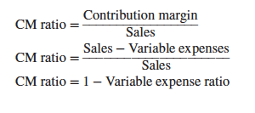

Step 3: Contribution Margin Ratio determined using the Variable Expense Ratio
Having defined the two terms, it bears emphasizing that the contribution margin ratio and the variable expense ratio can be mathematically related to one another:

Slide 35
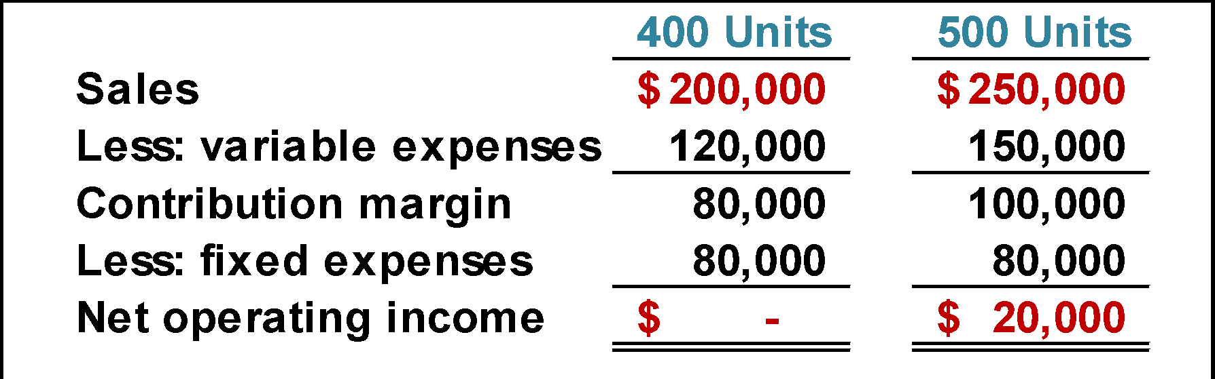
Applications of Contribution Margin Ratio: Increase in Sales Volume
If RBC increases sales from 400 to 500 bikes ($50,000), contribution margin will increase by $20,000 ($50,000 × 40%). Here is the long form proof:
A $50,000 increase in sales revenue results in a $20,000 increase in CM ($50,000 × 40% = $20,000).

Slide 36
Applications of Contribution Margin Ratio – Increase in Sales Volume
The relationship between profit and the CM ratio can be expressed using the following equation:
Profit = (CM ratio × Sales) – Fixed expenses
If RBC increased its sales volume to 500 bikes, what would management expect profit or net operating income to be?
Profit = (40% × $250,000) – $80,000
Profit = $100,000 – $80,000
Profit = $20,000

Slide 37
Poll 5
Coffee Klatch is an espresso stand in a downtown office building. The average selling price of a cup of coffee is $1.49 and the average variable expense per cup is $0.36. The average fixed expense per month is $1,300. An average of 2,100 cups are sold each month. What is the CM Ratio for Coffee Klatch?
a. 1.319
b. 0.758
c. 0.242
d. 4.139
Unit contribution margin
Unit selling price
CM Ratio =
($1.49 - $0.36)
$1.49
=
$1.13
$1.49
=
= 0.758

Slide 38
Poll 6
The Contribution Margin ratio is calculated by dividing contribution margin by operating income.
True
False

Slide 39
Learning Objective 4
Using CVP Concepts to Show the effects on net operating income of changes in variable costs, fixed costs, selling price, and volume.

Slide 40
Additional Applications of CVP Concepts – RBC Example 1
Example 1: Change in Fixed Cost and Sales Volume
What is the profit impact if RBC can increase unit sales from 500 to 540 by increasing the monthly advertising budget by $10,000?

Slide 41
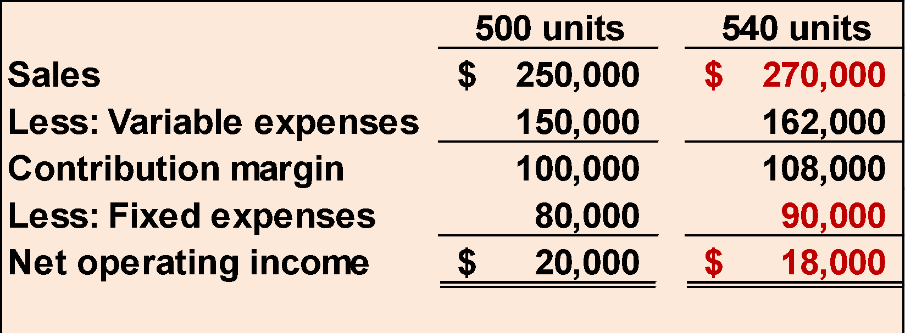
Additional Applications of CVP Concepts – Solution to Example 1
Example 1: Change in Fixed Cost and Sales Volume
$80,000 + $10,000 advertising = $90,000
Sales increased by $20,000, but net operating income decreased by $2,000.

Slide 42
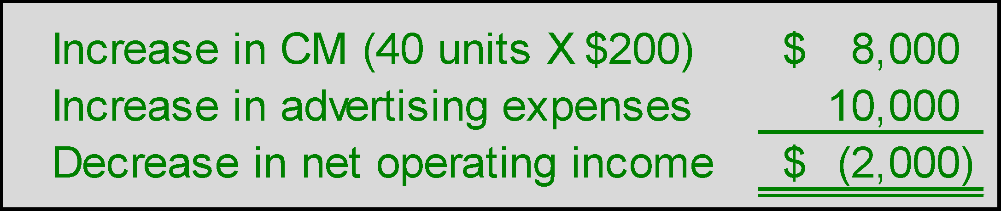
Additional Applications of CVP Concepts – A Shortcut
Example 1: Change in Fixed Cost and Sales Volume
A shortcut solution using incremental analysis

Slide 43
Additional Applications of CVP Concepts – RBC Example 2
Example 2: Change in Variable Costs and Sales Volume
What is the profit impact if RBC can use higher quality raw materials, thus increasing variable costs per unit by $10, to generate an increase in unit sales from 500 to 580?

Slide 44
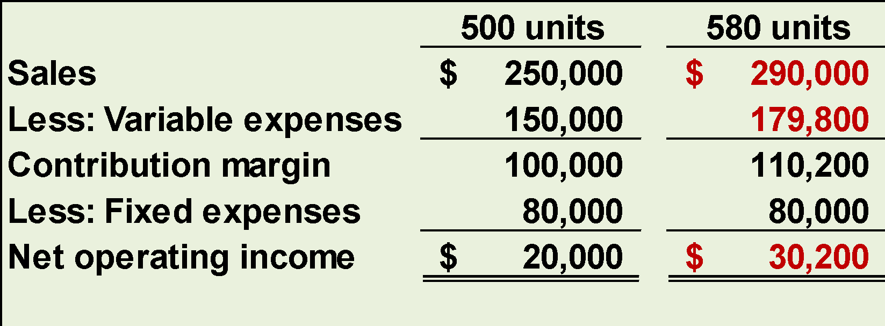
Additional Applications of CVP Concepts – Solution to Example 2
Example 2: Change in Variable Costs and Sales Volume
580 units × $310 variable cost/unit = $179,800
Sales increase by $40,000 and net operating income increases by $10,200.

Slide 45
Additional Applications of CVP Concepts – RBC Example 3
Example 3: Change in Fixed Cost, Selling Price, and Sales Volume
What is the profit impact if RBC:
cuts its selling price $20 per unit,
increases its advertising budget by $15,000 per month, and
increases sales from 500 to 650 units per month?

Slide 46
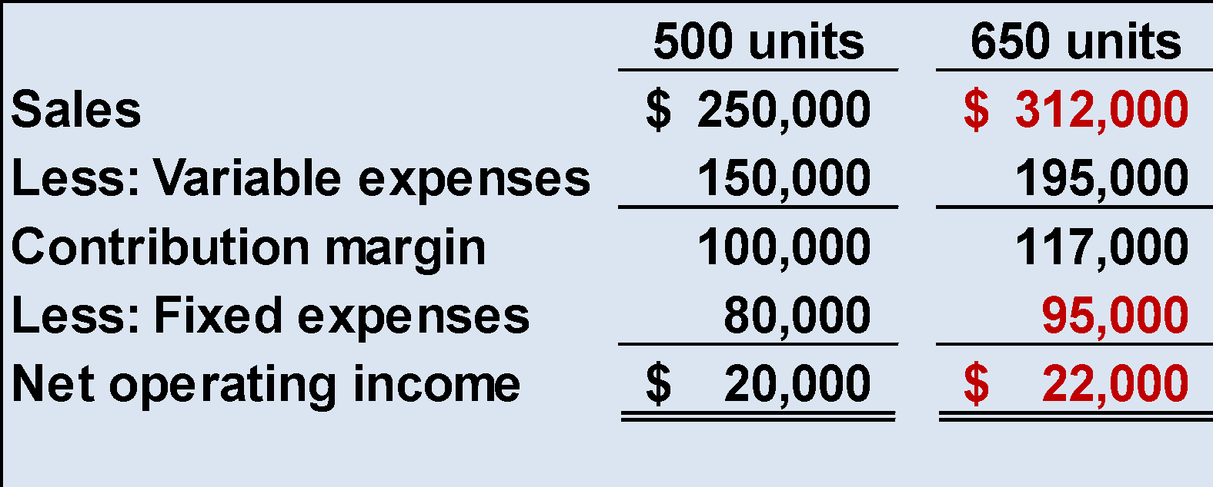
Additional Applications of CVP Concepts – Solution to Example 3
Example 3: Change in Fixed Cost, Selling Price, and Sales Volume
650 units × $480 = $312,000
Sales increase by $62,000, fixed costs increase by $15,000, and net operating income increases by $2,000.

Slide 47
Additional Applications of CVP Concepts – RBC Example 4
Example 4: Change in Variable Cost, Fixed Cost, and Sales Volume
What is the profit impact if RBC:
pays a $15 sales commission per bike sold instead of paying salespersons flat salaries that currently total $6,000 per month, and
increases unit sales from 500 to 575 bikes?

Slide 48
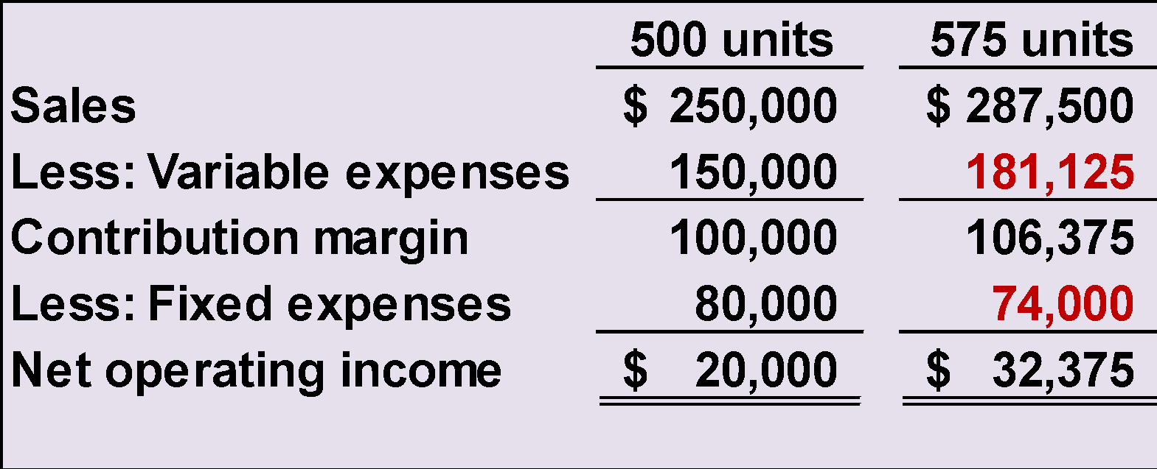
Additional Applications of CVP Concepts – Solution to Example 4
Example4: Change in Variable Cost, Fixed Cost, and Sales Volume
575 units × $315 = $181,125
Sales increase by $37,500, fixed expenses decrease by $6,000, and net operating income increases by $12,375.

Slide 49
Additional Applications of CVP Concepts – RBC Example 5
Example 5: Change in Selling Price
If RBC has an opportunity to sell 150 bikes to a wholesaler without disturbing sales to other customers or fixed expenses, what price would it quote to the wholesaler if it wants to increase monthly profits by $3,000?

Slide 50
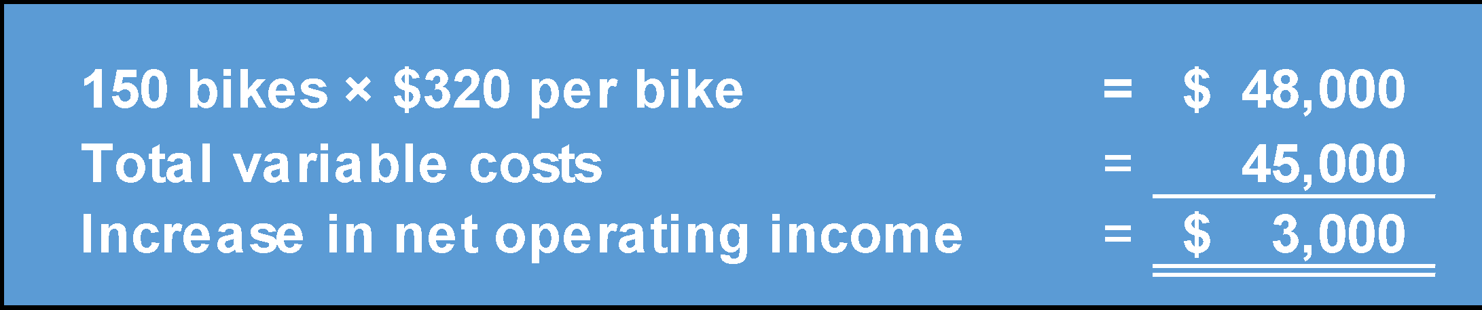
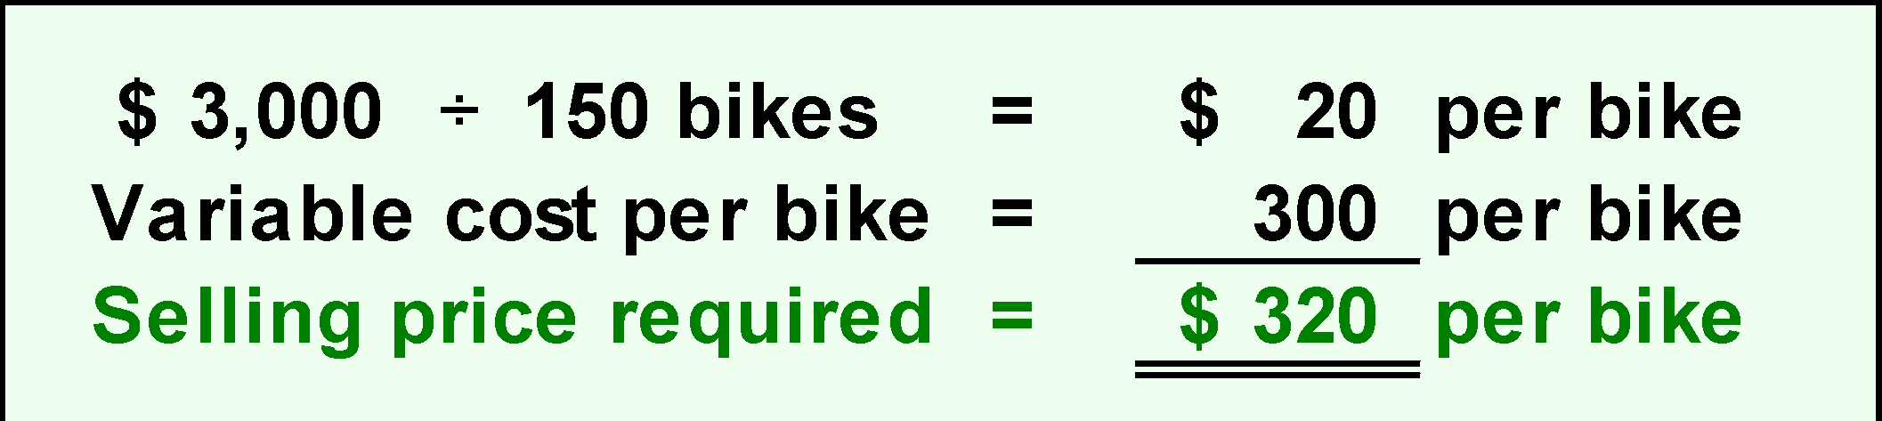
Additional Applications of CVP Concepts – Solution to Example 5
Example 5: Change in Selling Price

Slide 51
Poll 7
If fixed cost goes up by $200, but sales cost per unit and variable cost per unit stay the same, contribution margin will decrease.
True
False

Slide 52
Learning Objective 5
Determine the break-even point.

Slide 53
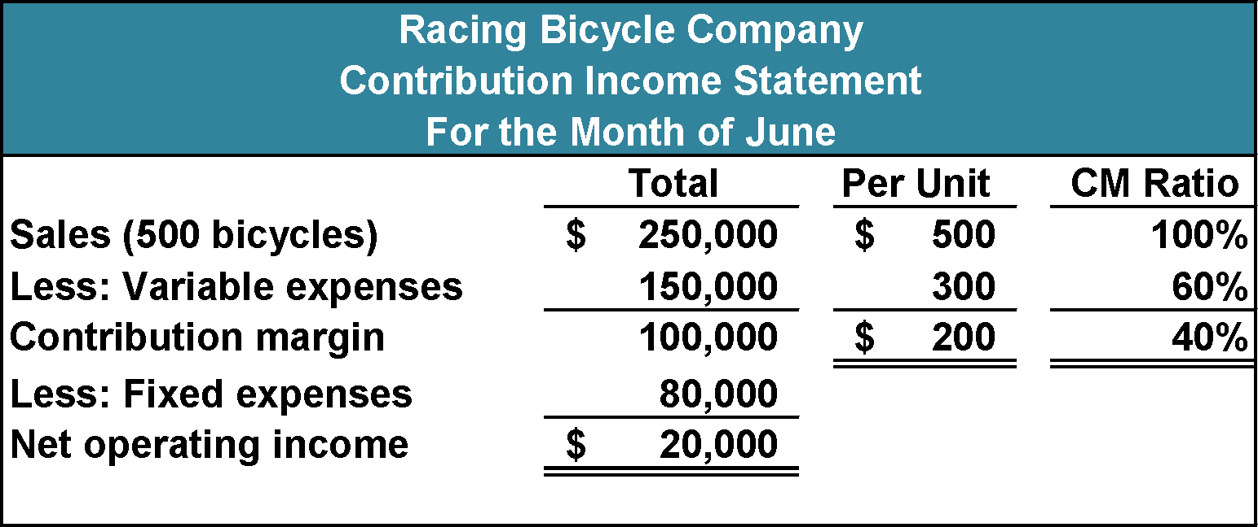
Break-Even Analysis
An equation or formula method can be used to determine the unit sales and dollar sales needed to achieve a target profit of zero. Let’s use the RBC information to complete the break-even analysis.

Slide 54
Break-Even Analysis: Unit Sales Needed Use CM /unit approach
Suppose RBC wants to compute the unit sales required to break-even. Let’s use the equation method and the formula methods to solve this problem.

Slide 55
Break-Even Analysis: Units Sales Needed Use CM / unit approach Equation Method
The equation method relies on the basic profit equation introduced earlier in the chapter. Because Racing Bicycle has only one product, we’ll use the contribution margin form of this equation to perform the break-even calculations. We calculate break-even by solving the equation below:
Profit = Unit CM × Q – Fixed expenses
$0 = $200 × Q – Fixed expenses
$200 × Q = $0 + $80,000
Q = $80,000 ÷ $200
Q = 400 units

Slide 56
Break-Even Analysis: Units Sales Needed Use CM / unit approach Formula Method
The formula method is a shortcut version of the equation method. It centers on the idea discussed earlier in the chapter that each unit sold provides a certain amount of contribution margin that goes toward covering fixed expenses.
Unit sales to break even =
Fixed expenses
Unit CM
$80,000
$200
=
= 400 Units
Note that this so called “Formula Method” is simply the key step in the Equation Method shown previously

Slide 57
Break-Even Analysis: Dollar Sales Needed Use CM ratio approach
Suppose RBC wants to compute the sales dollars required to break-even (earn a target profit of $0). Let’s use the equation method and the formula methods to solve this problem.

Slide 58
Break-Even Analysis: Dollar Sales Needed Use CM ratio approach Equation Method
The equation method is shown on this slide:
Profit = CM ratio × Sales – Fixed expenses
$ 0 = 40% × Sales – $80,000
40% × Sales = $80,000
Sales = $80,000 ÷ 40%
Sales = $200,000

Slide 59
Break-Even Analysis: Dollar Sales Needed Use CM ratio approach Formula Method
Now, let’s use the formula method to calculate the dollar sales at the break-even point.
Dollar sales to break even
Fixed expenses
CM ratio
=
$80,000
40%
Dollar sales =
Dollar sales = $200,000
Note that this so called “Formula Method” is simply the key step in the Equation Method shown previously

Slide 60
Poll 8
Coffee Klatch is an espresso stand in a downtown office building. The average selling price of a cup of coffee is $1.49 and the average variable expense per cup is $0.36. The average fixed expense per month is $1,300. An average of 2,100 cups are sold each month. What is the break-even sales dollars?
a. $1,300
b. $1,715
c. $1,788
d. $3,129
Break-even sales
Fixed expenses
CM Ratio
=
$1,300
0.758
=
= $1,715

Slide 61
Poll 9
Coffee Klatch is an espresso stand in a downtown office building. The average selling price of a cup of coffee is $1.49 and the average variable expense per cup is $0.36. The average fixed expense per month is $1,300. An average of 2,100 cups are sold each month. What is the break-even sales in units?
a. 872 cups
b. 3,611 cups
c. 1,200 cups
d. 1,150 cups
Fixed expenses
CM per Unit
Break-even
$1,300
$1.49/cup - $0.36/cup
=
$1,300
$1.13/cup
=
= 1,150 cups

Slide 62
Learning Objective 6
Determine the level of sales needed to achieve a desired target profit.

Slide 63
Target Profit Analysis
In target profit analysis, we estimate what sales volume is needed to achieve a specific target profit.

Slide 64
Target Profit Analysis
Profit = Unit CM × Q – Fixed expenses
Our goal is to solve for the unknown “Q” which represents the quantity of units that must be sold to attain the target profit.

Slide 65
Target Profit Analysis: Units Sales Needed Use CM / unit approach Equation Method
Suppose RBC’s management wants to know how many bikes must be sold to earn a target profit of $100,000.
Profit = Unit CM × Q – Fixed expenses
$100,000 = $200 × Q – $80,000
$200 × Q = $100,000 + $80,000
Q = ($100,000 + $80,000) ÷ $200
Q = 900 units

Slide 66
Target Profit Analysis: Units Sales Needed Use CM / unit approach Formula Method
Suppose RBC’s management wants to know how many bikes must be sold to earn a target profit of $100,000.
Unit sales to attain the target profit
Target profit + Fixed expenses CM per unit
=
$100,000 + $80,000
$200
Unit sales =
Unit sales = 900 units
Note that this so called “Formula Method” is simply the key step in the Equation Method shown previously

Slide 67
Target Profit Analysis: Dollar Sales Needed Use CM ratio approach Equation Method
Suppose RBC management wants to know the sales volume that must be generated to earn a target profit of $100,000.
Profit = CM ratio × Sales – Fixed expenses
$100,000 = 40% × Sales – $80,000
40% × Sales = $100,000 + $80,000
Sales = ($100,000 + $80,000) ÷ 40%
Sales = $450,000

Slide 68
Target Profit Analysis: Dollar Sales Needed Use CM ratio approach Formula Method
Dollar sales to attain the target profit
Target profit + Fixed Expenses
CM ratio
=
$100,000 + $80,000
40%
Dollar sales =
Dollar sales = $450,000
Note that this so called “Formula Method” is simply the key step in the Equation Method shown previously

Slide 69
Poll 10
Coffee Klatch is an espresso stand in a downtown office building. The average selling price of a cup of coffee is $1.49 and the average variable expense per cup is $0.36. The average fixed expense per month is $1,300. Use the formula method to determine how many cups of coffee would have to be sold to attain target profits of $2,500 per month.
a. 3,363 cups
b. 2,212 cups
c. 1,150 cups
d. 4,200 cups
Unit sales to attain target profit
Target profit + Fixed expenses
Unit CM
=
$2,500 + $1,300
$1.49 - $0.36
=
$3,800
$1.13
=
= 3,363 cups

Slide 70
Poll 11
Coffee Klatch is an espresso stand in a downtown office building. The average selling price of a cup of coffee is $1.49 and the average variable expense per cup is $0.36. The average fixed expense per month is $1,300. Use the formula method to determine the sales dollars that must be generated to attain target profits of $2,500 per month.
a. $2,550
b. $5,013
c. $8,458
d. $10,555
Sales $ to attain target profit
Target profit + Fixed expenses
CM ratio
=
$2,500 + $1,300
($1.49 – 0.36) ÷ $1.49
=
$3,800
0.758
=
= $5,013

Slide 71
Learning Objective 7
Compute the margin of safety and explain its significance.

Slide 72
The Margin of Safety in Dollars
The margin of safety is the excess of budgeted or actual sales dollars over the break-even volume of sales dollars. It is the amount by which sales can drop before losses are incurred. The higher the margin of safety, the lower the risk of not breaking even and incurring a loss.
Margin of safety in dollars = Total sales - Break-even sales
Let’s look at RBC and determine the margin of safety.

Slide 73
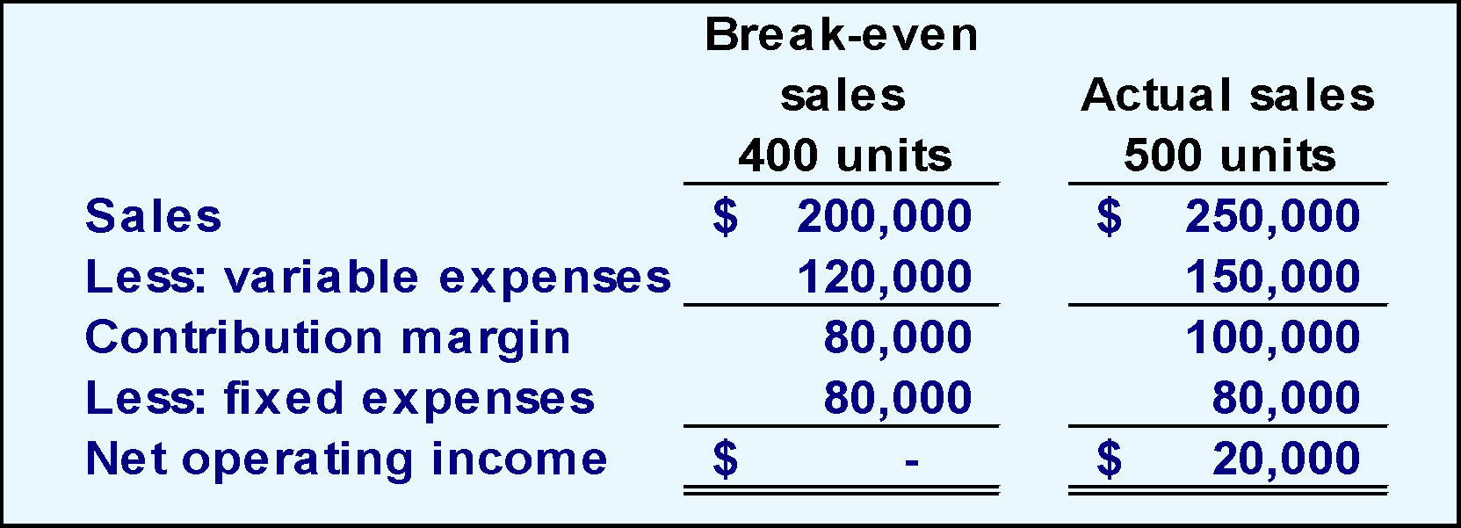
The Margin of Safety in Dollars – Example
If we assume that RBC has actual sales of $250,000, given that we have already determined the break-even sales to be $200,000, the margin of safety is $50,000 as shown.

Slide 74
The Margin of Safety Percentage
RBC’s margin of safety can be expressed as 20% of sales. ($50,000 ÷ $250,000)

Slide 75
The Margin of Safety in Units
The margin of safety can be expressed in terms of the number of units sold. The margin of safety at RBC is $50,000, and each bike sells for $500; hence, RBC’s margin of safety is 100 bikes.
Margin of Safety in units
$50,000 $500
=
= 100 bikes

Slide 76
Poll 12
Coffee Klatch is an espresso stand in a downtown office building. The average selling price of a cup of coffee is $1.49 and the average variable expense per cup is $0.36. The average fixed expense per month is $1,300. An average of 2,100 cups are sold each month. What is the margin of safety expressed in cups?
a. 3,250 cups
b. 950 cups
c. 1,150 cups
d. 2,100 cups
Margin of safety = Total sales – Break-even sales
= 2,100 cups – 1,150 cups Slide 61
= 950 cups

Slide 77
Poll 13
Margin of Safety= Total Sales-Break Even Sales
True
False

Slide 78
Learning Objective 8
Compute the degree of operating leverage at a particular level of sales and explain how it can be used to predict changes in net operating income.

Slide 79
Operating Leverage
Operating leverage is a measure of how sensitive net operating income is to percentage changes in sales. It is a measure, at any given level of sales, of how a percentage change in sales volume will affect profits.
Degree of
operating leverage
Contribution margin
Net operating income
=

Slide 80
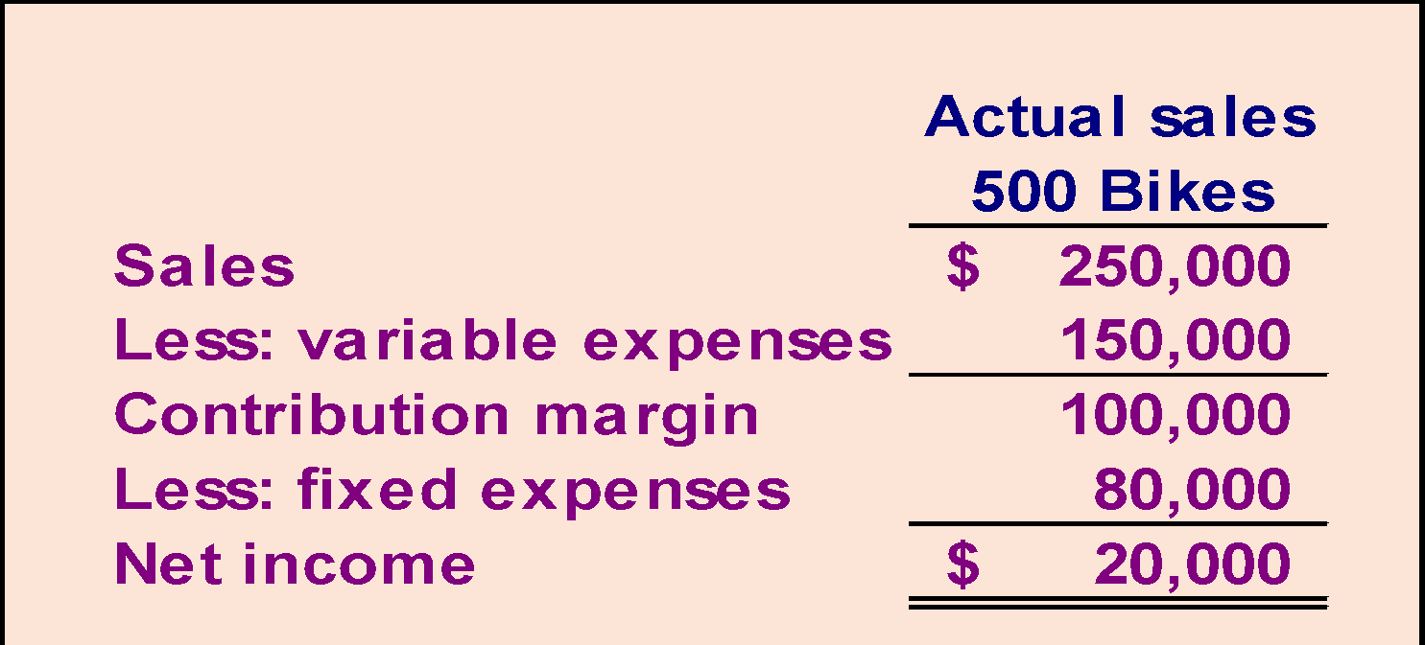
Operating Leverage – Example
To illustrate, let’s revisit the contribution income statement for RBC.
Degree of Operating Leverage
$100,000
$20,000
=
= 5

Slide 81
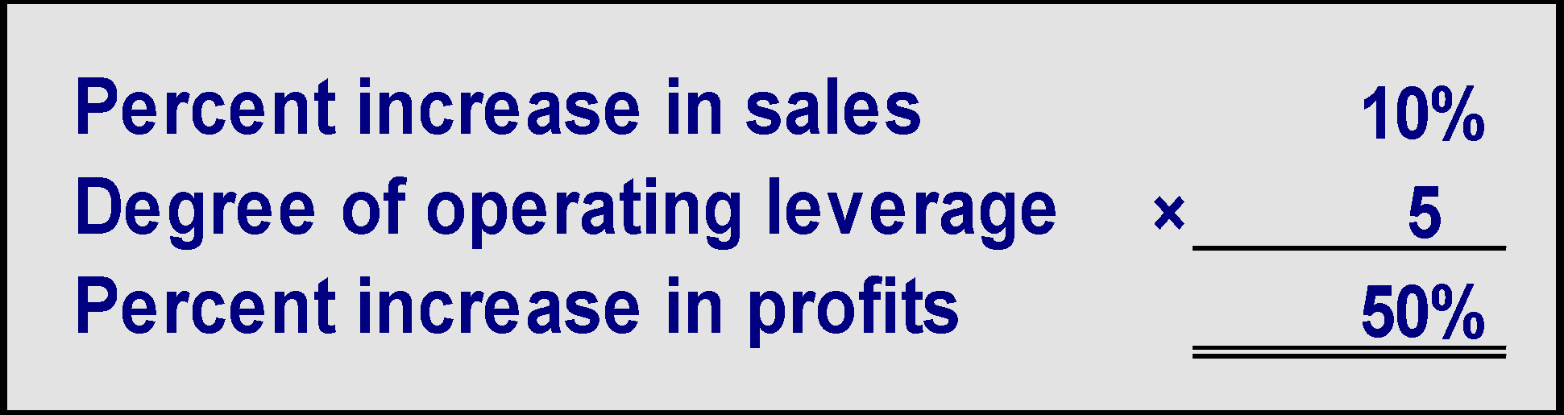
Operating Leverage – Changes in Profit
With an operating leverage of 5, if RBC increases its sales by 10%, net operating income would increase by 50%.
Here’s the verification!

Slide 82
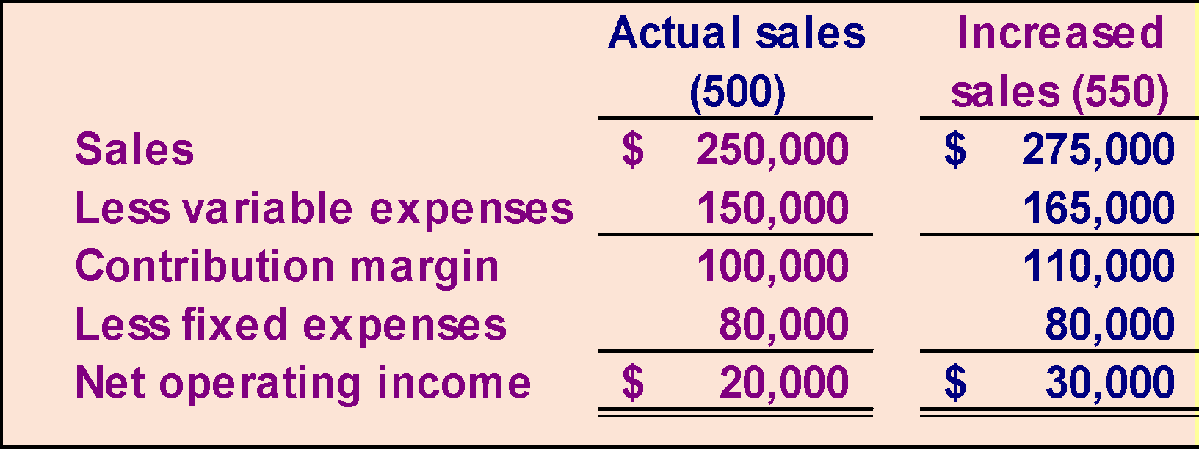
Operating Leverage – Proof of Changes
10% increase in sales from
$250,000 to $275,000 . . .
. . . results in a 50% increase in
income from $20,000 to $30,000.

Slide 83

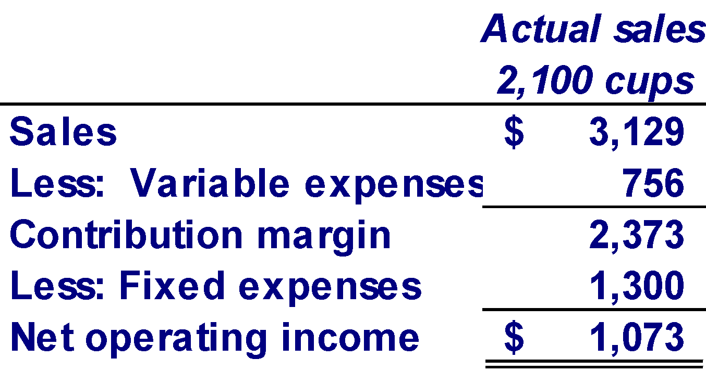
Poll 14
Coffee Klatch is an espresso stand in a downtown office building. The average selling price of a cup of coffee is $1.49 and the average variable expense per cup is $0.36. The average fixed expense per month is $1,300. An average of 2,100 cups are sold each month. What is the operating leverage?
a. 2.21
b. 0.45
c. 0.34
d. 2.92
Operating leverage
Contribution margin
Net operating income
=
$2,373
$1,073
=
= 2.21

Slide 84
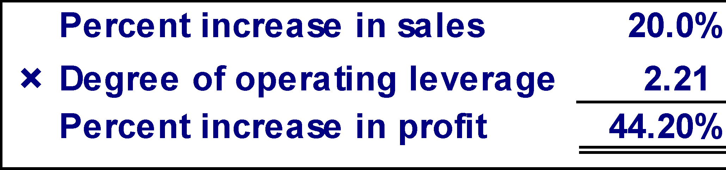
Poll 15
At Coffee Klatch the average selling price of a cup of coffee is $1.49, the average variable expense per cup is $0.36, the average fixed expense per month is $1,300, and an average of 2,100 cups are sold each month.
If sales increase by 20%, by how much should net operating income increase?
a. 30.0%
b. 20.0%
c. 22.1%
d. 44.2%

Slide 85
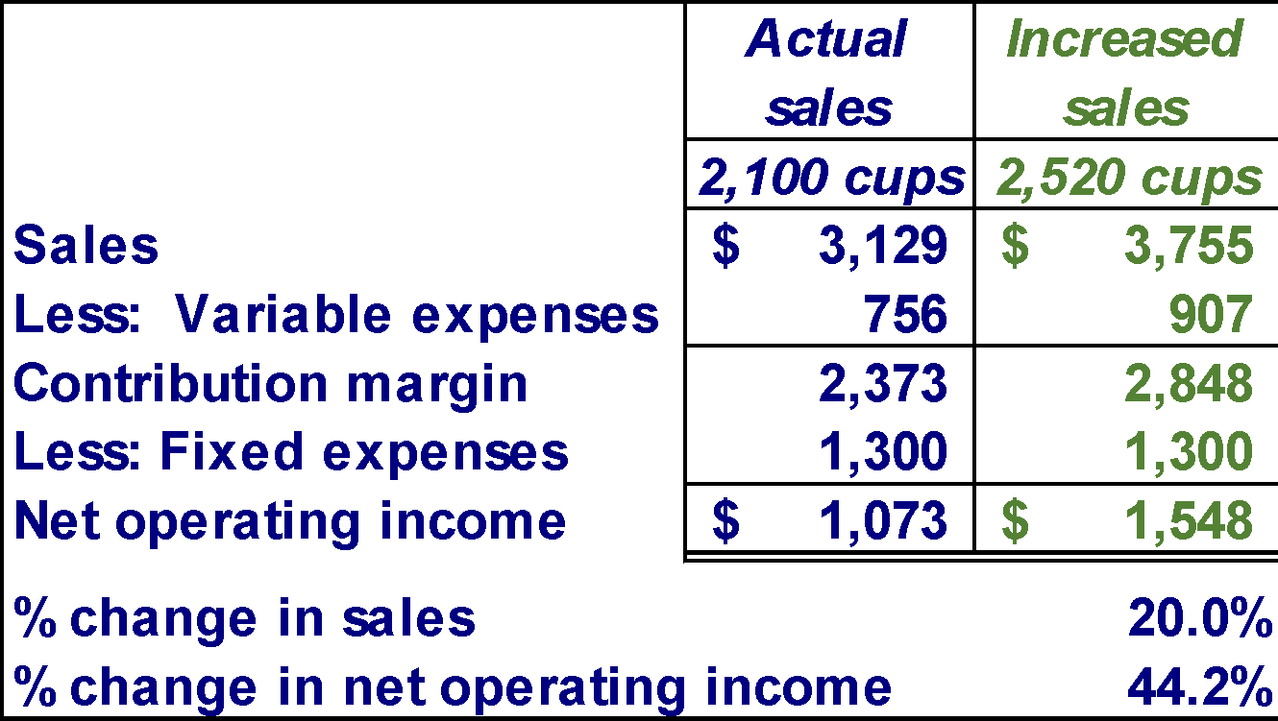
Poll Answer Verify Increase in Profit

Slide 86
Learning Objective 9
Compute the break-even point for a multiproduct company and explain the effects of shifts in the sales mix on contribution margin and the break-even point.

Slide 87
The Definition of Sales Mix
Sales mix is the relative proportion in which a company’s products are sold.
Different products have different selling prices, cost structures, and contribution margins.
When a company sells more than one product, break-even analysis becomes more complex as the following example illustrates.
Let’s assume RBC sells bikes and carts and that the sales mix between the two products remains the same.

Slide 88
Sales Mix and Break-Even Analysis –Part 1
Bikes comprise 45% of RBC’s total sales revenue and the carts comprise the remaining 55%. RBC provides the following information:
$265,000
$550,000
= 48.2% (rounded)

Slide 89
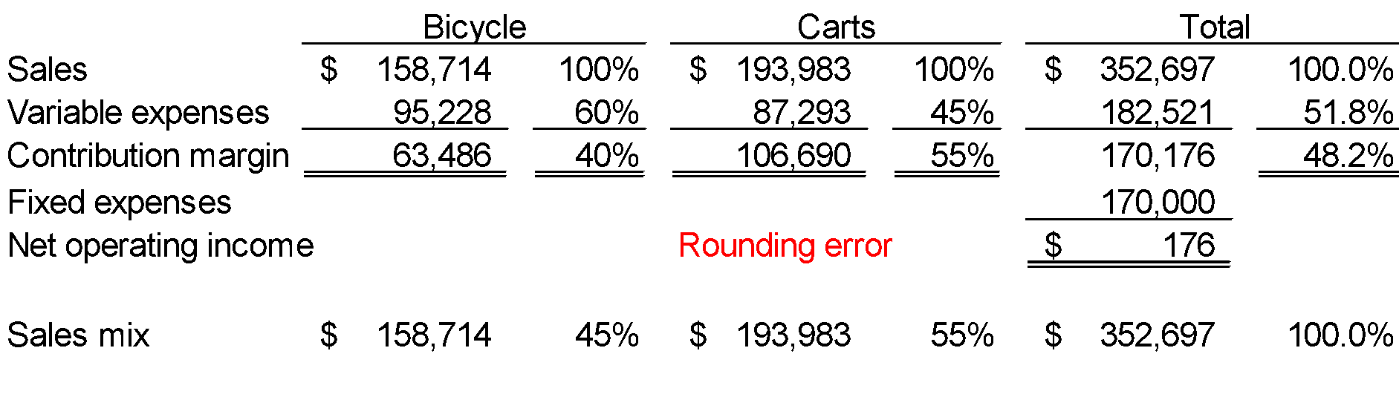
Sales Mix and Break-Even Analysis – Part 2
Dollar sales to break even
Fixed expenses
CM ratio
=
= $352,697 at company level vs $363,636 on a combined segment basis
Dollar sales to break even
$170,000 48.2%
=
Notes:
In BOOK:
1. This results in bike segment realizing they could slack off a bit and be carried by carts who has a higher CM ratio (because we know bikes has a BE of $200,000 from slide 59.
2. Also, if the sales mix changes after this forecast, the BE for the company in total will change, because each sale out of the 2 segments has a different CM ratio. For example, if sales falls only in carts, the overall CM ratio will decrease, and that will increase the amount of sales needed to E, ie FC/ CM

Slide 90
Poll 16
When a company begins to sell more than one product, break-even analysis is as simple as it was when the company sold one product.
True
False

Slide 91
End of Chapter 5

